Slide 1

Big Data, BI and Analytics

Slide 2
Reflection Essay
I am not looking for you to repeat back to me factual material we covered.
I am not looking for you to tell me what you think I want to hear.
I am not looking for compliments about how great the course was (unless you genuinely feel that way.)
I am not looking only for constructive criticism about the course in this reflection (although I am happy to accept it)
This document should be based on YOUR OWN reflection, not on reflection of what I should have done differently.
I am looking for you to take some time to reflect on what you will take away from this class in terms of the website assignment and the memos as it applies to enterprise technologies.
I am looking for you to hold on to this reflection essay (besides providing it to me) so that you can re-visit it later on in life, your career and your other courses. Has the content guided you towards making a IT career choice/track?

Slide 3
Refection Essay & Final Exam
Your Final Exam will ONLY be released to you after you submit your reflection essay on D2L.
Reflection essay is worth 5% of grade
It is meant for your own benefit. KEEP a COPY!
Final Exam is similar to your memos.

Slide 4
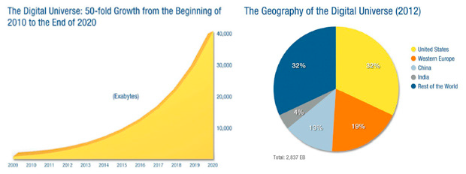
Digital Universe in 2020
1Exabyte=1000PetaBytes=1MillionTerraBytes=1BillionGigaBytes

Slide 5
What is the BUZZ around BIG DATA?
Source: David Wellman | http://www.slideshare.net/dwellman/what-is-big-data-24401517

Slide 6
Isn’t Big Data just big hype?
... How big is BIG?

Slide 7

What is it that we are really talking about?

Slide 8
“Big Data is the frontier S of a firm's ability to store, process, and access all the data it needs to operate effectively, make decisions, reduce risks, and serve customers.”
Forrester SAYS

Slide 9
“Big Data is the frontier of a firm's ability to store, process, and access all the data it needs to operate effectively, make decisions, reduce risks, and serve customers.”
Boring!
-- Forrester

Slide 10
“Big Data in general is defined as high volume, velocity and variety information assets that demand cost-effective, innovative forms of information processing for enhanced insight and decision making.”
Gartner SAYS

Slide 11
“Big Data in general is defined as high volume, velocity and variety information assets that demand cost-effective, innovative forms of information processing for enhanced insight and decision making.”
Snore
-- Gartner

Slide 12
“Big data is data that exceeds the processing capacity of conventional database systems. The data is too big, moves too fast, or doesn't fit the strictures of your database architectures. To gain value from this data, you must choose an alternative way to process it.”
O’Reilly Media SAYS

Slide 13
“Big data is data that exceeds the processing capacity of conventional database systems. The data is too big, moves too fast, or doesn't fit the strictures of your database architectures. To gain value from this data, you must choose an alternative way to process it.”
Too many
words
-- O’Reilly

Slide 14
“Big data is the data characterized by 3 attributes: volume, variety and velocity.”
IBM SAYS

Slide 15
“Big data is the data characterized by 3 attributes: volume, variety and velocity.”
Random
words
-- IBM

Slide 16
“Big data is the data characterized by 4 key attributes: volume, variety, velocity and value.”
Oracle SAYS

Slide 17
“Big data is the data characterized by 4 key attributes: volume, variety, velocity and value.”
Buzzwords
-- Oracle

Slide 18

So What is BIG DATA?

Slide 19
Let’s look at BIG DATA in a different way.

Slide 20
What was your first computer?

Slide 21
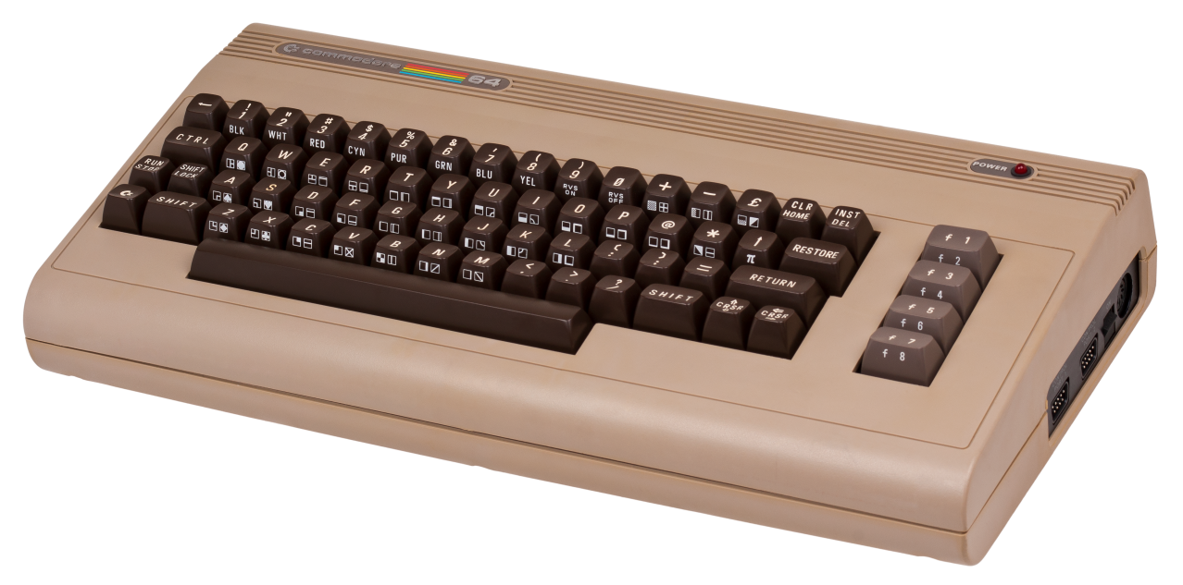

Most of you remember these??

Slide 22
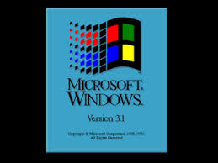
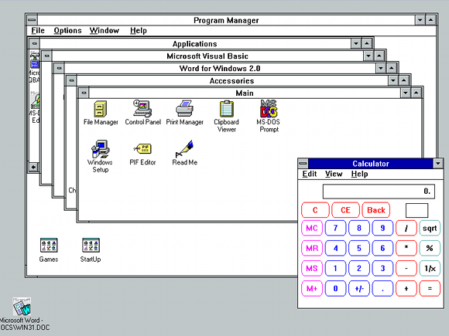
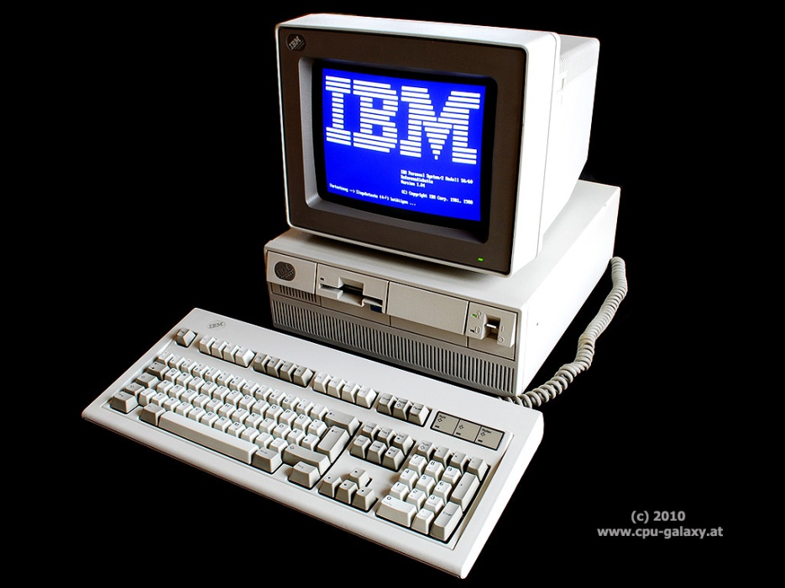
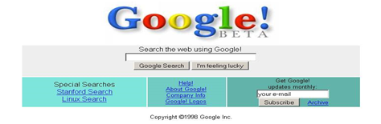
Or maybe these??

Slide 23
What was its “Big Data” limit?

Slide 24
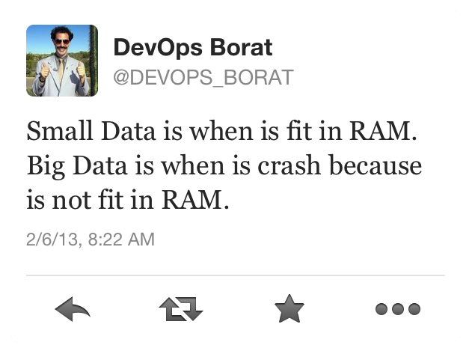

Slide 25
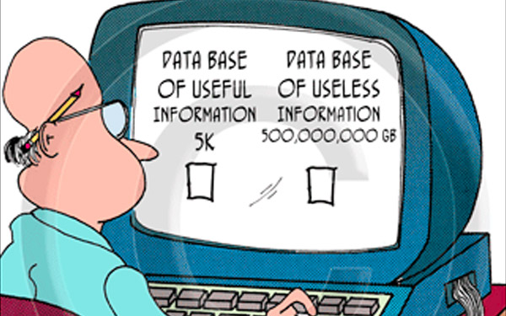
Let’s try again…

Slide 26


Byte : one grain of rice
Byte

Slide 27
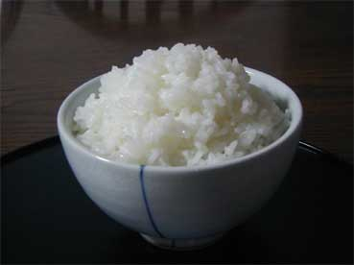
Byte : one grain of rice
Kilobyte : cup of rice
Kilobyte

Slide 28
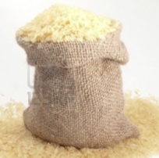
Byte : one grain of rice
Kilobyte : cup of rice
Megabyte : 8 bags of rice
Megabyte

Slide 29


Byte : one grain of rice
Kilobyte : cup of rice
Megabyte : 8 bags of rice
Gigabyte : 3 Semi trucks
Gigabyte

Slide 30

Byte : one grain of rice
Kilobyte : cup of rice
Megabyte : 8 bags of rice
Gigabyte : 3 Semi trucks
Terabyte : 2 Container Ships
Terabyte

Slide 31

Byte : one grain of rice
Kilobyte : cup of rice
Megabyte : 8 bags of rice
Gigabyte : 3 Semi trucks
Terabyte : 2 Container Ships
Petabyte : Blankets Manhattan
Petabyte

Slide 32
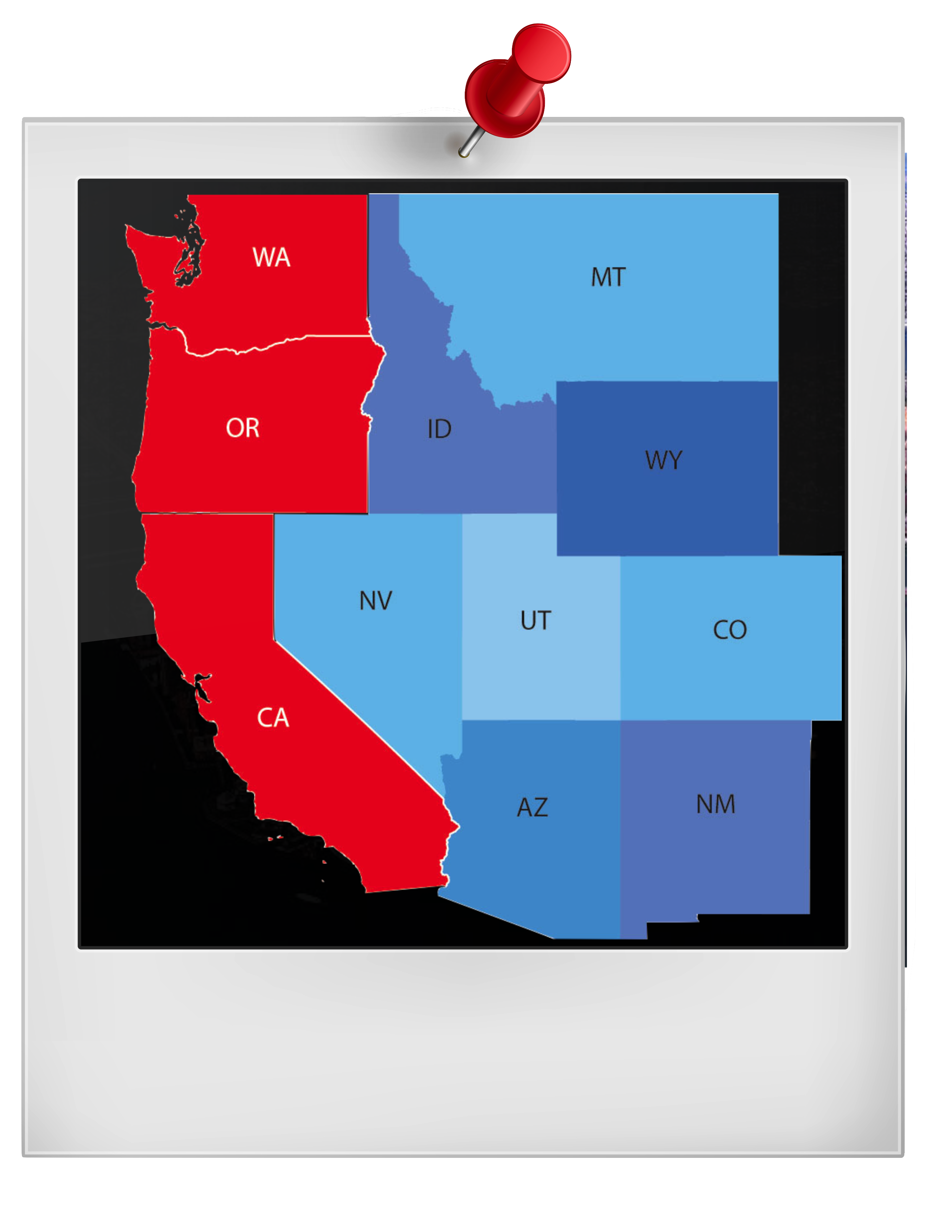
Byte : one grain of rice
Kilobyte : cup of rice
Megabyte : 8 bags of rice
Gigabyte : 3 Semi trucks
Terabyte : 2 Container Ships
Petabyte : Blankets Manhattan
Exabyte : Blankets west coast states
Exabyte

Slide 33

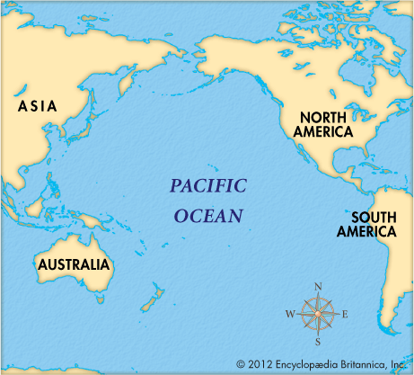
Byte : one grain of rice
Kilobyte : cup of rice
Megabyte : 8 bags of rice
Gigabyte : 3 Semi trucks
Terabyte : 2 Container Ships
Petabyte : Blankets Manhattan
Exabyte : Blankets west coast states
Zettabyte : Fills the Pacific Ocean
Zettabyte

Slide 34

Byte : one grain of rice
Kilobyte : cup of rice
Megabyte : 8 bags of rice
Gigabyte : 3 Semi trucks
Terabyte : 2 Container Ships
Petabyte : Blankets Manhattan
Exabyte : Blankets west coast states
Zettabyte : Fills the Pacific Ocean
Yottabyte : A EARTH SIZE RICE BALL!
Yottabyte

Slide 35
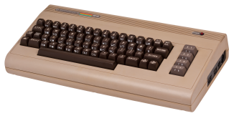
Byte : one grain of rice
Kilobyte : cup of rice
Megabyte : 8 bags of rice
Gigabyte : 3 Semi trucks
Terabyte : 2 Container Ships
Petabyte : Blankets Manhattan
Exabyte : Blankets west coast states
Zettabyte : Fills the Pacific Ocean
Yottabyte : A EARTH SIZE RICE BALL!
Hobbyist

Slide 36
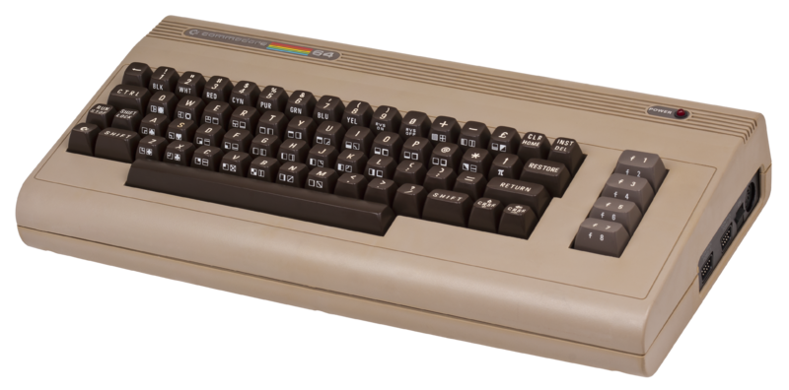
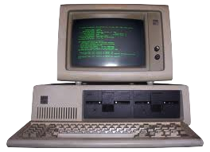
Byte : one grain of rice
Kilobyte : cup of rice
Megabyte : 8 bags of rice
Gigabyte : 3 Semi trucks
Terabyte : 2 Container Ships
Petabyte : Blankets Manhattan
Exabyte : Blankets west coast states
Zettabyte : Fills the Pacific Ocean
Yottabyte : A EARTH SIZE RICE BALL!
Hobbyist
Desktop

Slide 37

Hobbyist
Byte : one grain of rice
Kilobyte : cup of rice
Megabyte : 8 bags of rice
Gigabyte : 3 Semi trucks
Terabyte : 2 Container Ships
Petabyte : Blankets Manhattan
Exabyte : Blankets west coast states
Zettabyte : Fills the Pacific Ocean
Yottabyte : A EARTH SIZE RICE BALL!
Desktop
Internet

Slide 38


Byte : one grain of rice
Kilobyte : cup of rice
Megabyte : 8 bags of rice
Gigabyte : 3 Semi trucks
Terabyte : 2 Container Ships
Petabyte : Blankets Manhattan
Exabyte : Blankets west coast states
Zettabyte : Fills the Pacific Ocean
Yottabyte : A EARTH SIZE RICE BALL!
Hobbyist
Desktop
Internet
Big Data

Slide 39





Byte : one grain of rice
Kilobyte : cup of rice
Megabyte : 8 bags of rice
Gigabyte : 3 Semi trucks
Terabyte : 2 Container Ships
Petabyte : Blankets Manhattan
Exabyte : Blankets west coast states
Zettabyte : Fills the Pacific Ocean
Yottabyte : A EARTH SIZE RICE BALL!

Slide 40
Hobbyist
Byte : one grain of rice
Kilobyte : cup of rice
Megabyte : 8 bags of rice
Gigabyte : 3 Semi trucks
Terabyte : 2 Container Ships
Petabyte : Blankets Manhattan
Exabyte : Blankets west coast states
Zettabyte : Fills the Pacific Ocean
Yottabyte : A EARTH SIZE RICE BALL!
Desktop
Internet
Big Data
The Future?

Slide 41

Utah Governor Herbert on June 11, 2012 told the annual meeting of the National Governors' Association that the NSA's 1,500,000 square foot data center being built outside Salt Lake City will be the first facility to house a yottabyte of data.
NSA Response: “While the actual capacity is classified for NATIONAL SECURITY REASONS, we can say this: The Utah Data Center was built with future expansion in mind and the ultimate capacity will definitely be "alottabytes"! ”

Slide 42
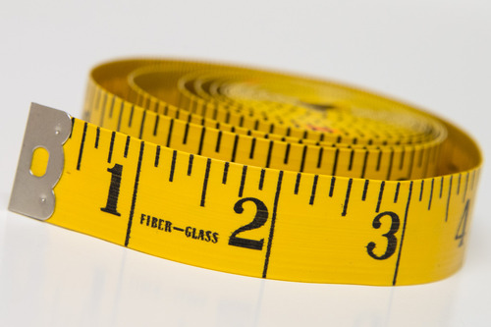
Big Data is not about the size of the data, it’s about the value within the data.

Slide 43

So, what is value?

Slide 44

Market Intelligence? Business Intelligence? Secret Intelligence?

Slide 45

Our society is leaving behind a digital footprint.

Slide 46
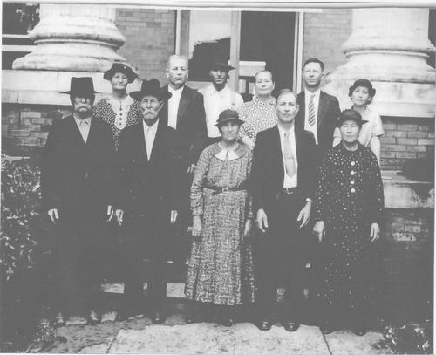
People are living online and we all are expressing our attitudes, likes and dislikes, our opinions and perspectives.

Slide 47

We are generating huge amounts of data.
Data with a lot of information.

Slide 48
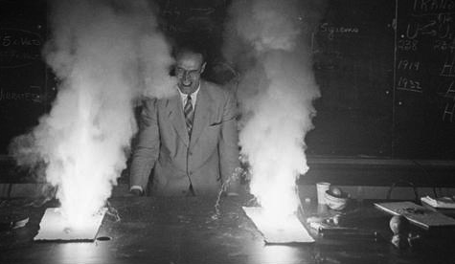
… and a lot of noise.

Slide 49

The ability to hear the signal from the noise is the key…

Slide 50

to unlocking the human conversation that is taking place around us.

Slide 51
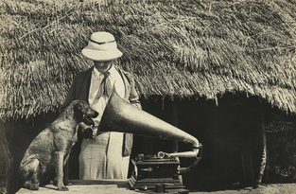
Listening to this conversation can lead us to…
Unexpected Discoveries

Slide 52

Case Study on BIG DATA

Slide 53



Slide 54
“House of Cards” was one of the first major test cases of this Big Data-driven creative strategy.
For a year, Netflix executives told the public that their detailed knowledge of Netflix subscriber viewing preferences made them decide to license a remake of the popular and well regarded 1990 BBC miniseries.
Netflix’s data indicated that the same subscribers who loved the original BBC production also were interested in movies starring Kevin Spacey.
Therefore, Netflix executives concluded that a remake of the BBC drama with Spacey was a no-brainer….
….to the tune of $100 million for two 13-episode seasons.

Slide 55
What do you think? Did it work?

Slide 56

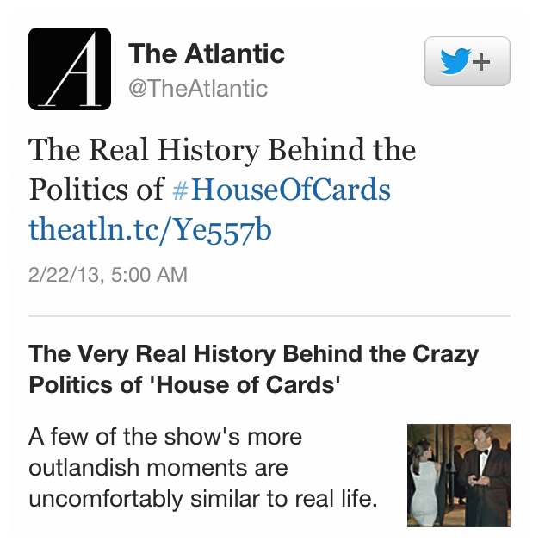
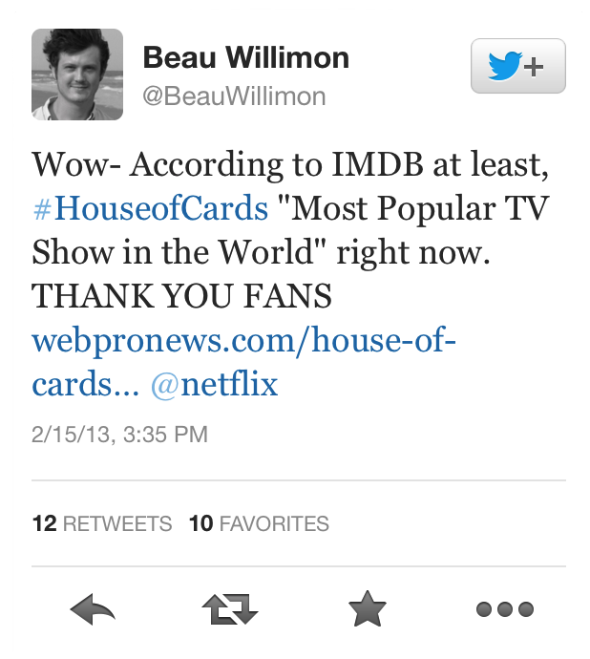



Slide 57
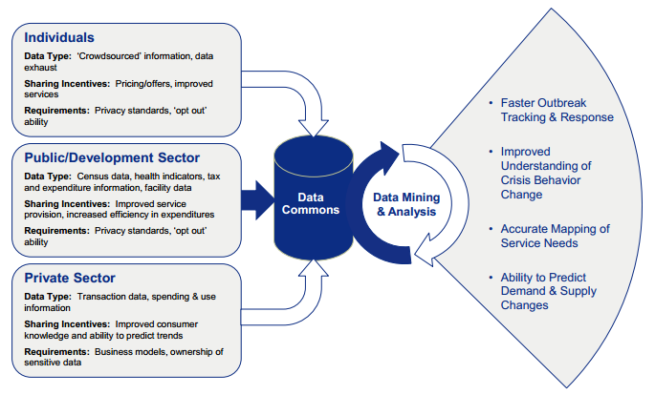
Big Data
A meme* and a marketing term, for sure, but BIG DATA is shorthand for advancing trends in technology, that open the door to a new approach to understanding the world and making decisions. –NY Times, 2012
Source:
World Economic Forum: Big Data, Big Impact: New Possibilities for International Development
*A meme can be considered an idea carried from person to person (usually imitated)

Slide 58
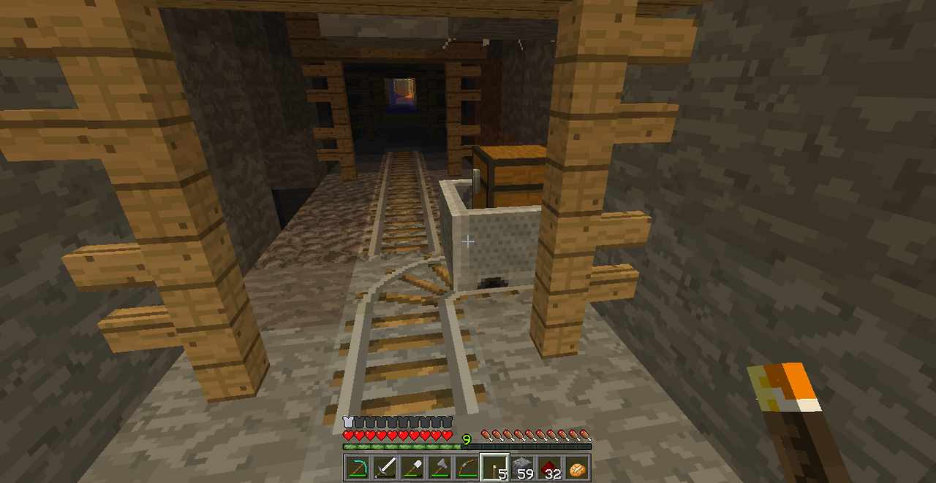
How do you mine (and mind) all this data?

Slide 59

Most people don’t know what to do with all the data that they already have…

Slide 60

Here’s how to do it - Get BIG by starting small

Slide 61
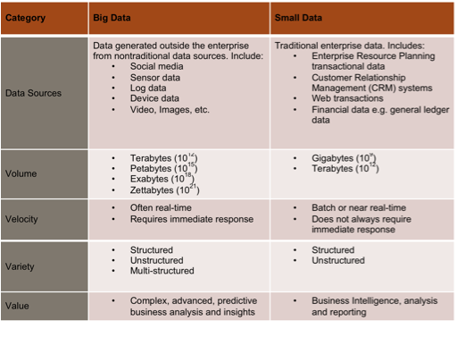

Slide 62
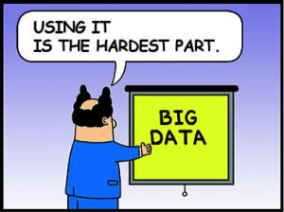
Focus on Business Impact.

Slide 63
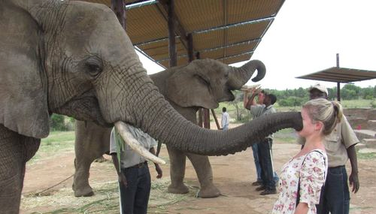
Start
Try
Something
NO
YES
Did it
Work?
YES
STOP

Slide 64

Big Data Impacts
It is NOT just about size
It is about complexity, not just transactional data
Includes new data types
Video streams, images, audio, social networks, external datasets (as actual data or as metadata and links from blogs, communities, etc). Context aware data, previous searches, preferences, ratings and stuff we don’t know about yet! (Predictive)

Slide 65


Not just storage
Although storage of these large data sets is an issue
Processing of the variety of data types is a computational issue
Pattern-based strategies, e-discovery, information governance, context-aware computing
Current information management and technologies too often focus only on volume

Slide 66

Its about Information Architecture
Real-time data – perishable data
Shared data – used across applications – must be consistent, usable and extensible
Linked data – sourced from different sets but with relationships, must maintain the context to useful (using RDF or URI*)
High-fidelity data – preserves context, detail, relations, and identities but also allows for new meanings (without destroying old one)
*RDF—Resource Description Framework, URI – Uniform Resource Identifiers
Notes:
RDF- Resource Description Framework
RDF is a standard model for data interchange on the Web
URI - Uniform resource identifier
URI is a string of characters used to identify a name of a resource. The most common form of URI is URL (Uniform resource locator)

Slide 67
Information Architecture
Big data suggests a new scenario for information architecture that allow us to solve problems we cannot address today.
How?
If data can be analyzed rapidly by moving the application to the data, instead of the other way around, we can move multiple scenarios to the data very quickly.
Instead of determining data quality rules processing for batch applications, the same data quality rules can be moved to the data along with the analytics model.
When we remove the issue of data transport and processing along the "route," we can analyze information under multiple scenarios very quickly.

Slide 68
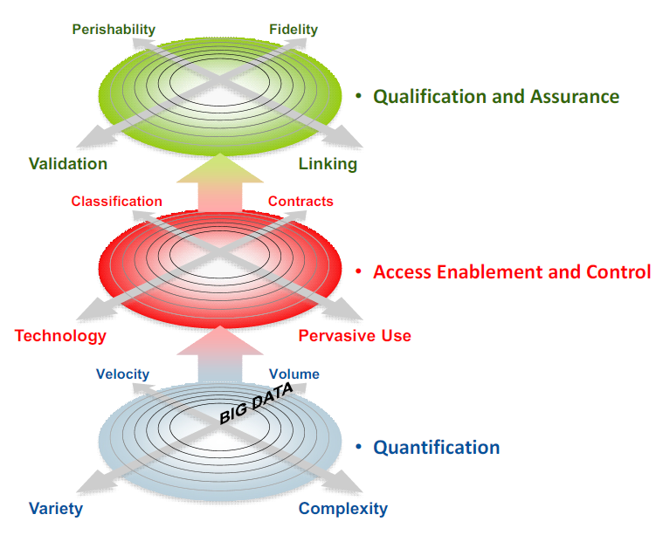
12 Dimensions of Information Management*
Qualification and assurance:
Fidelity
Linked data
Validation of Data
Perishability
Access enablement and control
Classification
Contracts
Pervasiveness
Technology-enablement
Quantification
Volume
Velocity of data streams,
access demand, record creation
Variety of data forms
Complexity of data types
Notes:
Quantification:
■Velocity means both how fast data is being produced and how fast the data must be
processed to meet demand. Velocity involves streams of data, structured record creation, and availability for access and
delivery.
■ Variety includes tabular data (databases), hierarchical data, documents, e-mail, metering data,
video, image, audio, stock ticker data, financial transactions and more.
■ Complexity means that different standards, domain rules and even storage formats can exist
with each asset type. An information management system for media cannot have only one
video solution.
Access and Control:
Classification includes sensitive/non-sensitive and private/public classifications and an
understanding their implications. Authorization and security fit here, as does public or private
information.
■ Contracts involve agreements on who will share information and how — both inside and outside
the enterprise — usually represented by metadata. This dimension also includes the terms of
sharing, how the records will be exposed, the intended use, how long can you use the
information and so on. These contracts are required to satisfy compliance requirements,
especially with respect to external data transfers between enterprises, such as a retailer
sending files to a data enrichment service to add demographic detail to customer information.
■ Pervasiveness refers to information and data that becomes "hot" and is in great demand across
the organization. How long does data remain active? What do you do with orphaned data that
has outlived its value but for some reason keeps hanging around?
■ Technology-enablement involves specifications derived from the other 11 dimensions that guide
the design and integration infrastructure of systems such as data integration tools, data quality
tools, master data management and application middleware.
Qualification and Assurance
These dimensions relate to the levels of trust that users can place in data. Addressing qualification
and assurance can help with Pattern-Based Strategy, social networking and analysis.
■ Fidelity means the ability or inability to confidently adapt an asset for wider use.
■ Linking involves data in combination and the uses related to this context.
■ Validation ensures that the information was created in accordance with complete understanding
of the use cases and includes all the other aspects of data quality. Unknown future use cases
make validation a constant challenge.
■ Perishability refers to the confidence that the data remains valid and reaches all use cases while
it remains so. What is the shelf-life of the information? How long does it remain useful? How
long should it be kept? What are the aging aspects of information?

Slide 69
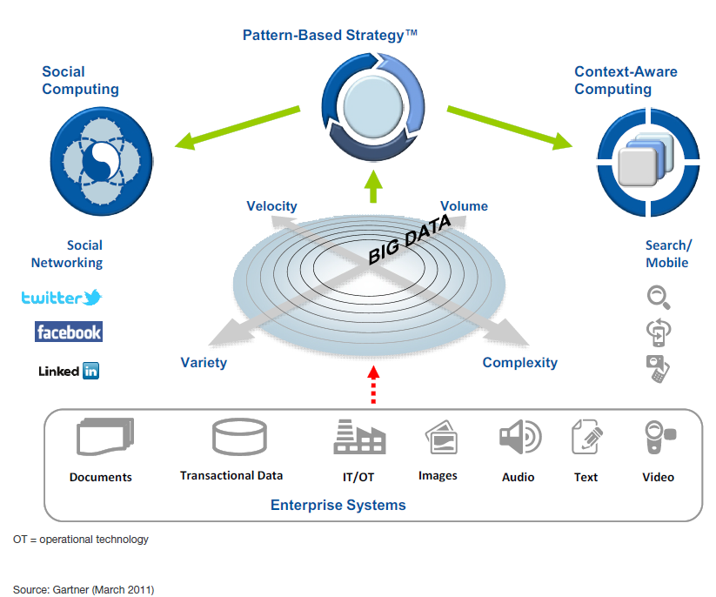
Pushing Information to Extremes

Slide 70



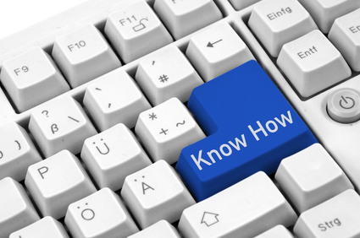
Big Data isn’t big, if you know how to use it.

Slide 71
The Economics of Data
IT must think about big data and all the dimensions it implies
The Internet openly and rapidly distributes massive amounts of content at low cost
Leads to widespread access and information sharing creating depth and breadth of connections and relationships.
In a Hyperconnected age
Users are empowered
IT leaders may never have the control they once had
Change from being the sole owner of the technology stack to being a business partner and technology steward
Help their business counterparts understand how to use new technologies and new data sources,
And educating them on the risks
Everyone with an Internet browser can become an information specialist.
* From Gartner, “Big Data is only the beginning of Extreme Data Management,” 2011
Notes:
More data and more technology introduce more risk (and potentially more costs). These challenges reach their peak in the widening array of data sources available to the business — that is, in the big-data phenomenon

Slide 73
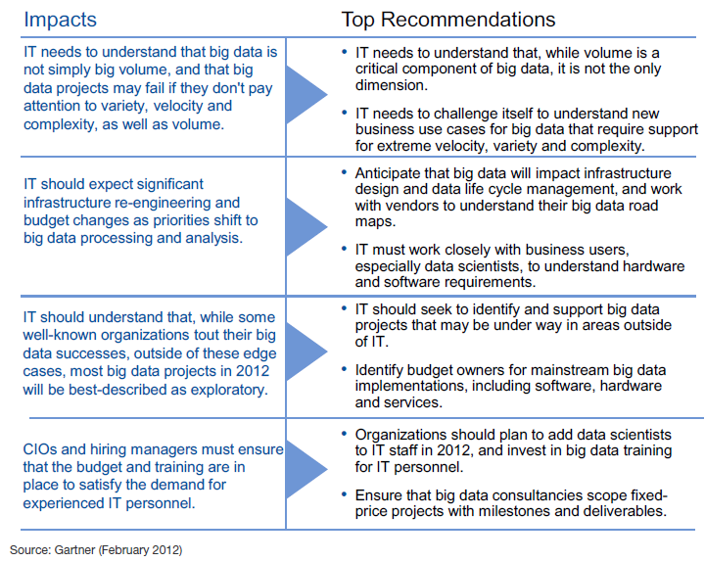
Big Data Challenges for IT Infrastructure Team
* From Gartner, “Big Data Challenges for IT Infrastructure Team,” 2012
BIG data is not big volume
Expect significant infrastructure re-engineering
BIG data projects currently are exploratory – what about in 2015?
Enough budget and training is in place

Slide 74

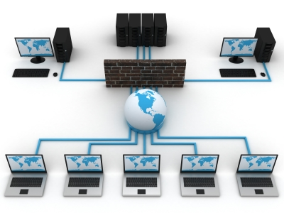
Not all organizations are ready
0% of companies report that their IT infrastructure is fully prepared to meet the demand of big data
62% of companies plan to increase their infrastructure spend in the next 12-18 months
WHY?
What is the # 1 reason why companies invest in IT infrastructure?
To achieve a competitive advantage !!
Source: IBM Corporation: Why Infrastructure Matters for Big Data & Analytics
Notes:
Source: IBM Corporation: Why Infrastructure Matters for Big Data & Analytics

Slide 75
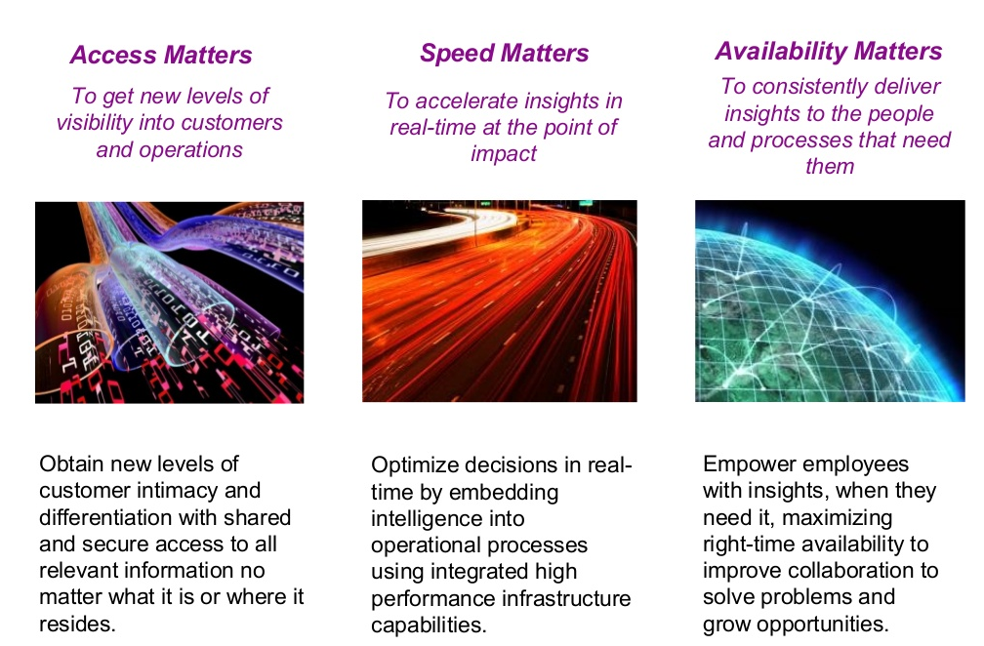
Does the IT Infrastructure Matter?
Notes:
Source: IBM Corporation: Why Infrastructure Matters for Big Data & Analytics

Slide 76
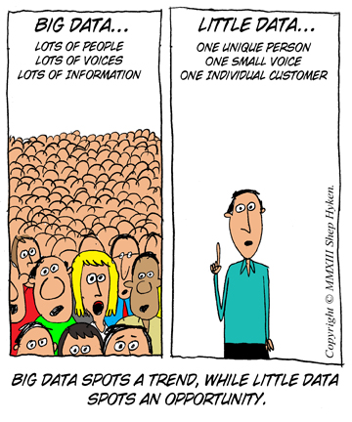
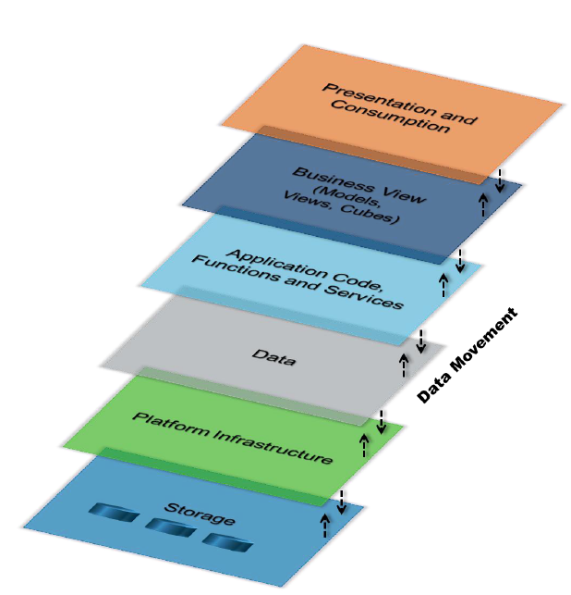
Big Data Stack
Data Visualization
Intermediate Data Structure
MapReduce
Complexity
Hadoop process
Hadoop clusters
Notes:
A Hadoop cluster is a special type of computational cluster designed specifically for storing and analyzing huge amounts of unstructured data in a distributed computing environment.
MapReduce is a software framework that allows developers to write programs that process massive amounts of unstructured data in parallel across a distributed cluster of processors or stand-alone computers.

Slide 77
Platform Notes
Big Data analytics cannot be run on traditional transactional servers (serially processed on fixed sized records)
Need simultaneous and parallel processing of variable length records
Specialized server clusters
Most are automated, but still require specialized IT support
Shift in Data Center flows and loads
Both transactional and analytic need equal priority
Notes:
Data analytics can not be run on traditional transactional servers
Must be distributed and parallel (because of the amount of data that needs to be sifted through)
Equal importance to transactional and analytical data

Slide 78
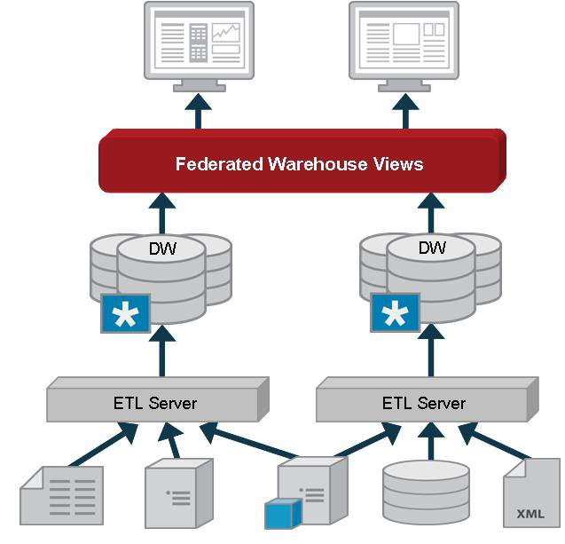
Data Federation
DBMS, mapping multiple autonomous database systems into a “virtual” database
Uses data abstraction to provide uniform user interface into data from multiple locations
Requires strict Master Data Management (DB can be heterogeneous, data cannot or requires one to one schema mapping)

Slide 79
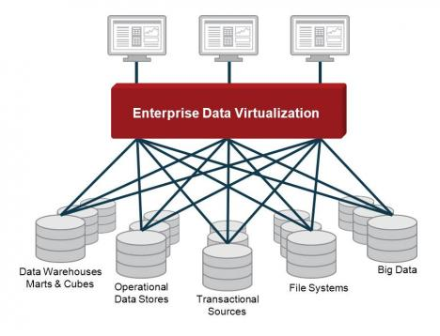
Data Virtualization
Allows for the retrieval and manipulation of data without needing the technical details about the data (like api, format, location)
Data remains in place
Reduces data errors, duplications
Does not require a single data model
Supports data updates to source system.

Slide 80
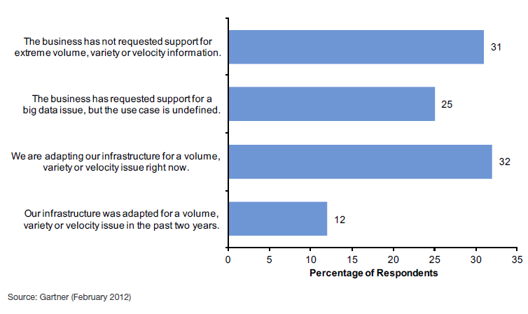
What describes Big Data in Organizations today?
* From Gartner, Big Data Challenges for IT Infrastructure Team,

Slide 81
What Technologies are being Deployed?

Slide 82
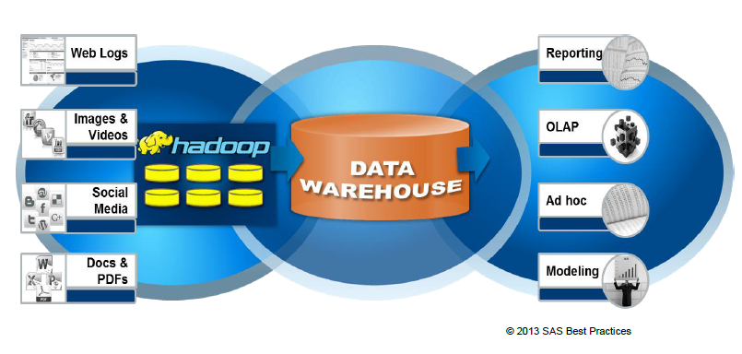
Big Data & Warehouse

Slide 83
“CIOs and Hiring Managers Must Ensure That the Budget and Training Are in Place to Satisfy the Demand for Experienced IT Personnel. Without Skilled People, Big Data Projects Will Churn Data, but Will Lack Intelligence”
* From Gartner, “Big Data Challenges for IT Infrastructure Team,”

Slide 84
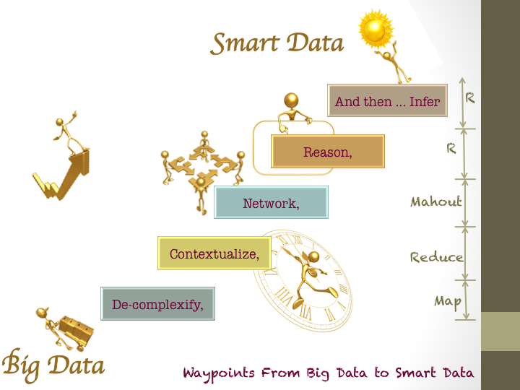
This all leads to….. SMART DATA

Slide 85
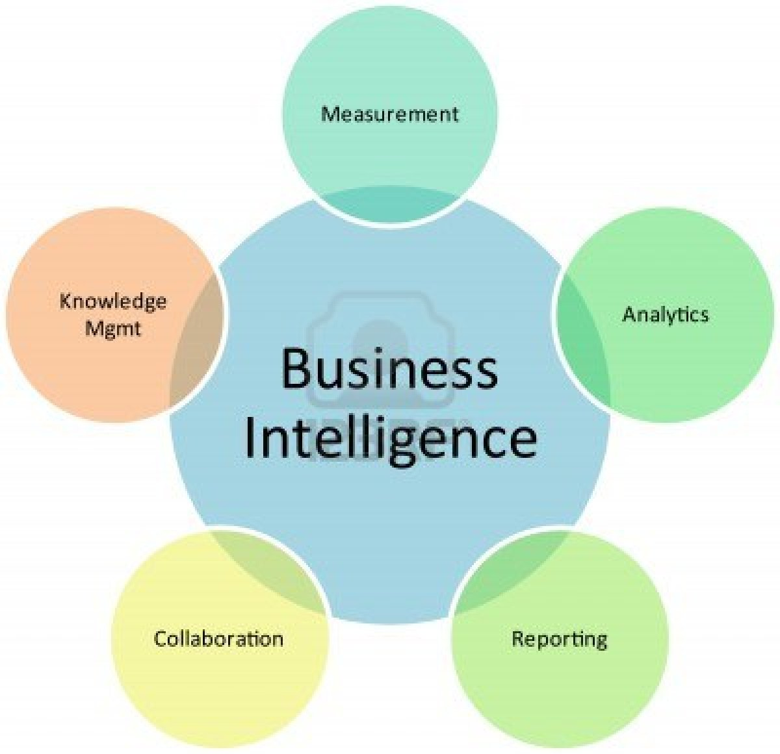

Slide 86
What is Business Intelligence
Umbrella term
Software used to analyze organizations raw data
Discipline made up of related activities
Data mining, online analytical processing, querying, and reporting
Used to improve decision making, cut costs
Id new business opportunities
Used by business without IT intervention
Analytics is a subset of BI (or maybe the umbrella?)

Slide 87
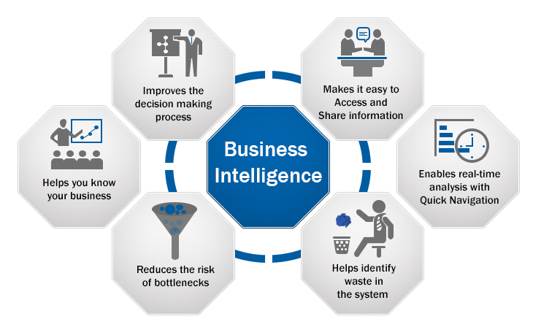
Business Intelligence

Slide 88
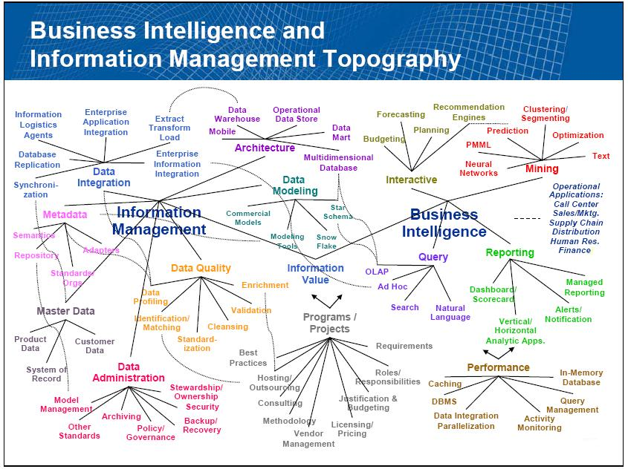

Slide 89
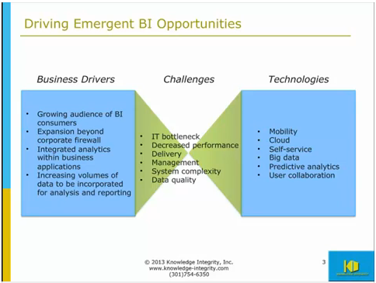

Slide 90
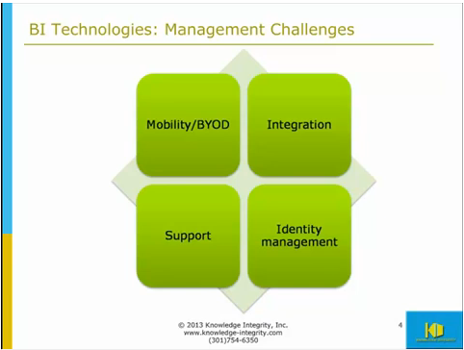
Changing sources

Slide 91
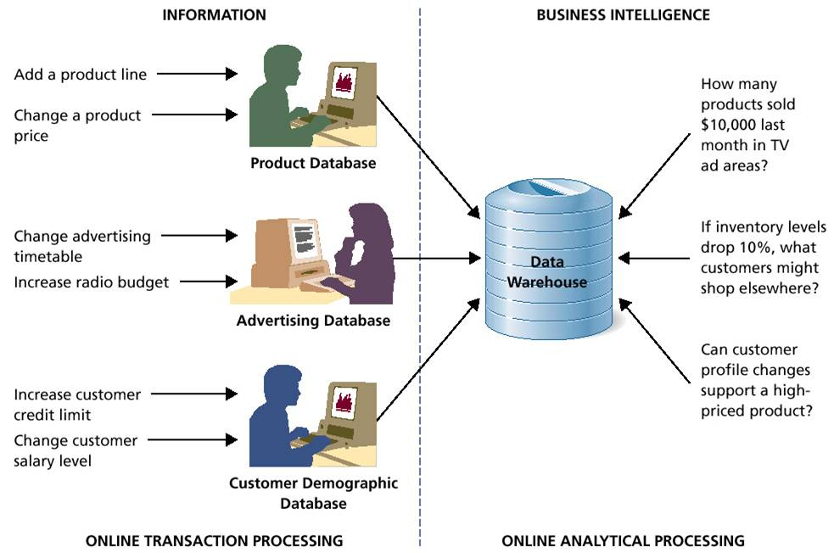

Slide 92
Issues?
User resistance
Poor data quality (too much irrelevant stuff)
This one is critical
BI tools
They are easier and more scalable than they used to be, don’t confuse BI with BA
Understand Business Processes before you use analysis to change them

Slide 93
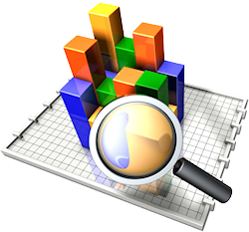
What is Business Analytics?
Defined by Gartner as “the applications, infrastructures, tools and best practices that enable access to and analysis of information to improve and optimize decisions and performance. Specifically includes BI platforms, corporate performance management suites, analytical applications and performance management, among other elements of BI.”

Slide 94
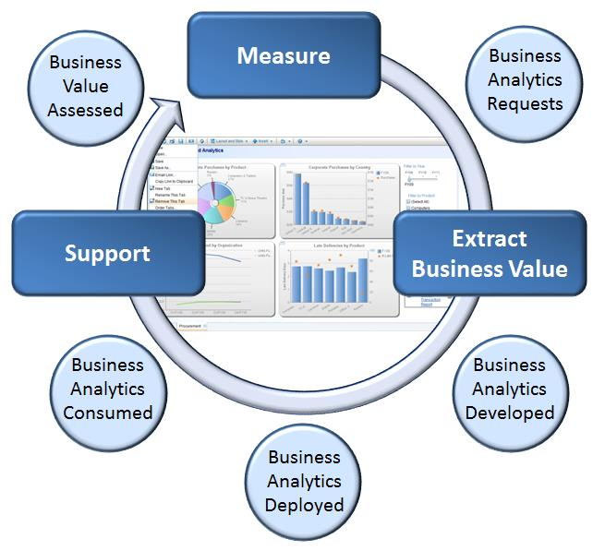

Slide 95
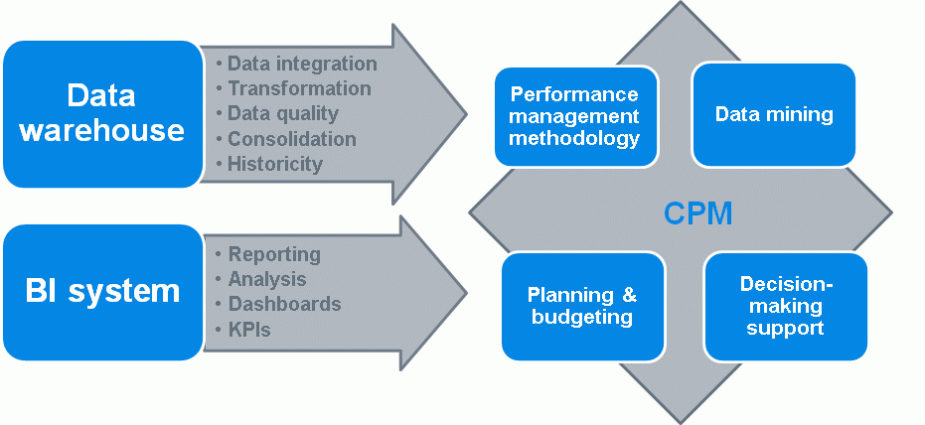
Business Analytics
Data doesn’t need to be squeaky clean
Requires more varied data sets (so a federal approach to data across the organization is required)
Uses both structured and unstructured data sources
Not a product (not a project either) but a long-term program

Slide 96
History – Analytics 1.0
1954 – UPS initiated an analytics group to research delivery routes
2009 – still working with “small” data
Structured, internally sourced
Stored in warehouses or marts before analysis
Reporting was the tool
Few compete on “analytics”

Slide 97
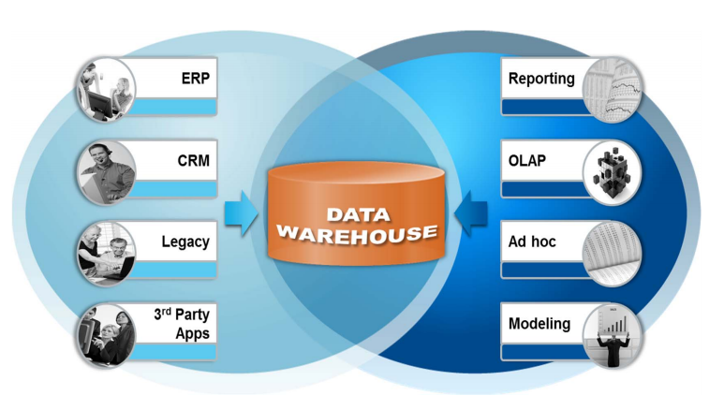
Analytics 1.0 Data environment

Slide 98
Analytics 1.0 Data technology
Standalone spreadsheets
BI and analytics “packages”
ETL* tools
OLAP** array cubes
On-premise servers
*ETL-Extract, transform, load
**OLAP-online analytical processing

Slide 99
Analytics 1.0 Culture
Stay in the back room—as far away from decision-makers as possible—and don’t cause trouble
Take your time—nobody’s that interested in your results anyway
Talk about “BI for the masses,” but make it all too difficult for anyone but experts to use
Look backwards—that’s where the threats to your business are
If possible, spend much more time getting data ready for analysis than actually analyzing it
Stay inside the confines of the IT organization

Slide 100
History Analytics 2.0
2005 – 2012
Beginning of Big Data from Internet based firms – Google, Yahoo, eBay
Informed internal decision, and basis for customer facing products and processes
Most large companies confined efforts to basic domains – customer relations, product review
Rarely integrated with other data sets
Stand alone process, with often externally sourced data and often unstructured
Fast flow required fast processing and analysis
Era of the “Data Scientist”

Slide 101
Analytics 2.0 Data environment

Slide 102
Analytics 2.0 Data technology
Google—Search, AdSense, Books, Maps, Scholar, etc., etc.
LinkedIn—People You May Know, Jobs You May Like, Groups You May Be Interested In, etc.
Netflix Cinematch, Max, etc.
Zillow Zestimates, rent Zestimates, Home Value Index, Underwater Index, etc.
Facebook People You May Know, Custom Audiences, Exchange

Slide 103
Analytics 2.0 Culture
Be “on the bridge”, if not in charge of it
“Agile is too slow”
“Being a consultant is the dead zone - too hard to get things implemented”
Develop products, not presentations or reports
Information (and hardware and software) wants to be free and shared
All problems can be solved in a hackathon
“Nobody’s ever done this before!”

Slide 104
Analytics 3.0?
Blend of 1.0 and 2.0 traditional analytics and big data
Insights, offerings with speed and impact
Firms in all industries (not just internet-based) are seeing the “light”
Multiple data types, internal, external, structured, unstructured (complexity)
Volume and speed
Integration with existing data sets
Predictive and Prescriptive
Varied and integrated “teams”
Notes:
Descriptive – report on past
Predictive – uses models based on past data to predict the future
Prescriptive – uses models to specify optimal behaviors and actions.

Slide 105
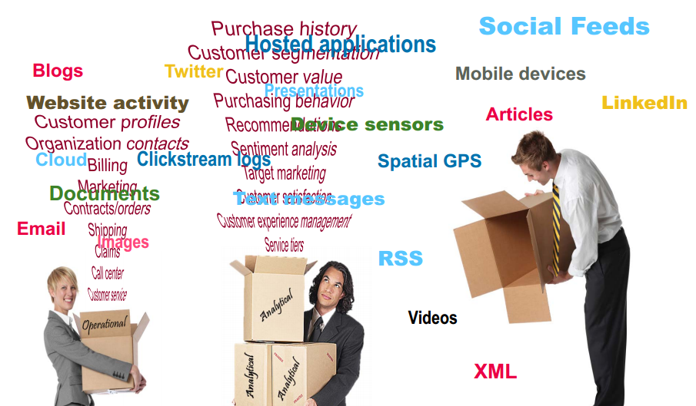
Analytics 3.0 Data types

Slide 106


Analytics 3.0 Data Technology
Analytical “apps”
Integrated and embedded models
Focus on data discovery
Heavy use of visual analytics
Faster technology and analytical methods
Blended data science/analytics/IT teams
Chief Analytics Officers (Chief Data Officers)
Use of prescriptive and predictive analytics

Slide 107
Analytics 3.0 Culture
Any firm in any industry can participate!
Use “data exhaust” to help customers use your products and services more effectively
Start with data opportunities or start with business problems? Answer is yes!
Need “data products” team good at data science, customer knowledge, new product/service development
Everything’s Much Faster!
In-memory analytics
In-database processing
Everything’s Much Cheaper!

Slide 108

Three Types of Companies
Analytical Innovators 11%
Analytically
Challenged
29%
Analytical Practitioners 60%
http://sloanreview.mit.edu/article/lessons-from-analytical-innovators/

Slide 109

http://sloanreview.mit.edu/article/lessons-from-analytical-innovators/

Slide 110

http://sloanreview.mit.edu/article/lessons-from-analytical-innovators/

Slide 111

http://sloanreview.mit.edu/article/lessons-from-analytical-innovators/

Slide 112

http://sloanreview.mit.edu/article/lessons-from-analytical-innovators/

Slide 113

http://sloanreview.mit.edu/article/lessons-from-analytical-innovators/

Slide 114
Skills?
Ability to manipulate big data technologies
Natural Language processing, Text mining skills, video or image analytics
Visual analytics
Scripting language proficiency – Python, Pig, Hive

Slide 115
Train or Hire the right Skills
Cross-functional
Business analysts
Data scientists
Collaboration specialists
Change Management specialists
Communications specialists

Slide 116
Operational BA
Focus on effective and efficient
Forecast supply chain flows
Workflow processing
Customized but repeatable
Repeatability helps to keep costs down
But customers expect specialized treatment and personalized interactions
Which customer gets which offer, which location gets how much of each product
Driven by data
Changing from decision by habit rather than data

Slide 117

Decision Management

Slide 118
Business Analytics
Sports teams use business analytics to explore
On field – select players, stay below salary cap, study game film
Off field used to study “total fan experience”
Food, parking personnel, bathroom cleanliness, etc
In retail, Wal-Mart is a data king
Amazon isn’t just e-commerce
Dunkin donuts isn’t just about the coffee

Slide 119
This ends Module 9
Before Module 10 :
Finish up on D2L discussion boards
WordPress assignments
Memo 7
if you need to do it.
Next class will be our last class.
Take home Final will be released after end of class 10
It is due July 19, 2015, 11:30pm. NO EXCEPTIONS!
Friendly Reminder:
Please fill out DePaul Class Survey.
It helps DePaul (and me) determine how we can improve the class for future students.

